Slide 1
Historical analysis of stocks,
to evaluate growth, fluctuation, risk, and potential future performance.
Authors: Cesar Zea, Xingjia Wang,
Angelo,
Levan Getia

Slide 2
Introduction and Methodology
Project Outline: We aim to analyse historical stock data to identify stocks with the highest percentage price changes,
lowest standard deviation, and a combination of both. We also predict future prices and compare
with real-time data
Methodology: We have used Python with Pandas, NumPy, Matplotlib, SciPy for data analysis, and linear regression
for future price prediction. We've also used a real-time stock data API for comparison.
Project Usage: Young investors are looking for information to choose stocks to invest on. The DYI investments trend
is growing. Based on this, evaluating different stocks to find the right ones to grow, considering the
risk aversion of investors is important.

Slide 3
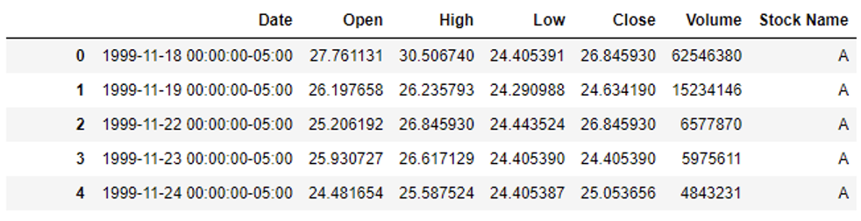
Data Collection and Preparation
Data Retrieval: All of the data used is provided by NASDAQ index. The database file was retrieved from kaggle.com
and stock files are presented in .csv format. Code, analyses all the files that are in .csv format in the
‘Stocks’ directory. Files are inclusive of Date, Price, Open, Close, Volume and Stock Name
Data cleaning: To ensure, robustness of our analysis, we have performed several data cleaning steps, such as
excursion of missing values, ensuring each column is of the proper data type, for example we
converted ”Date” column to datetime format for time series analysis. After these steps, we had
clean usable data ready for analysis

Slide 4
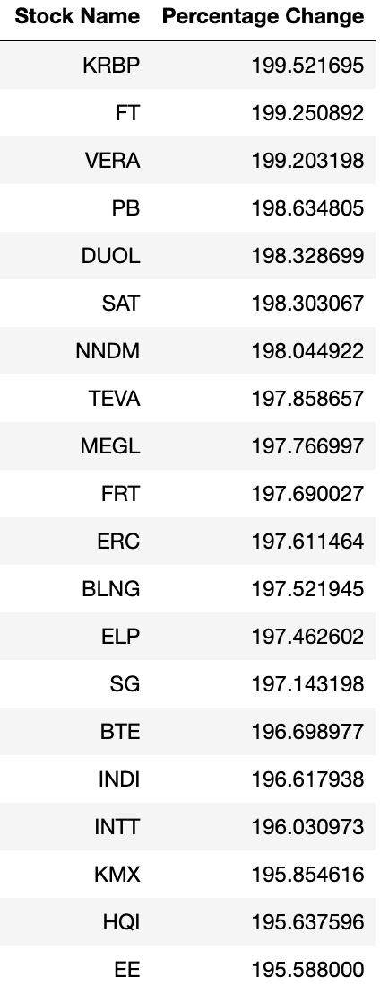
Analysis – Retrieving top 20 stock with highest price change
Stock selection for analysis: Since dataset offered by NASDAQ index is very
extensive and offers historical data from 20th century
onwards, to avoid any misconceptions or usage of
unchecked data, we decided to select last 8 years interval,
as our most relevant information for stock volatility
or price gain prediction.
Only top 20 stocks are included are showing price change of up to 200%
Table Description: Stocks are ranked in descending order from highets price change
to the lowest.

Slide 5
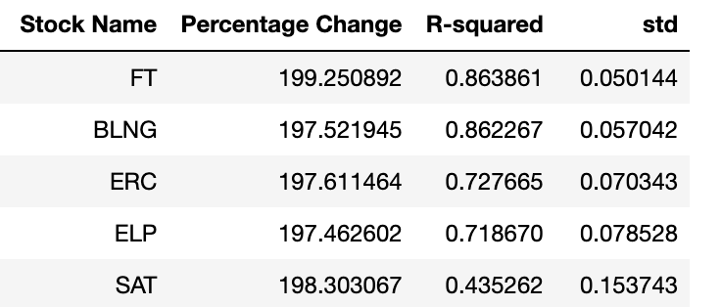
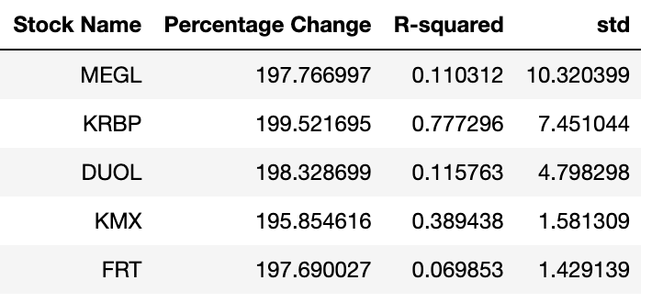
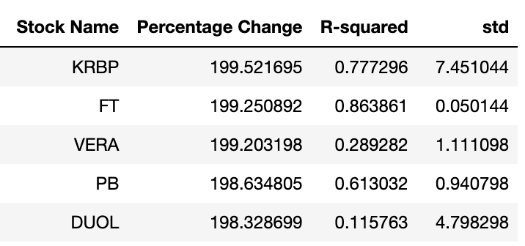
Analysis – top 5 stocks with categories
Top 5 stocks with highest gain and lowest variance
Top 5 stocks with highest gains, highets volatility
Top 5 stocks with highest gain

Slide 6
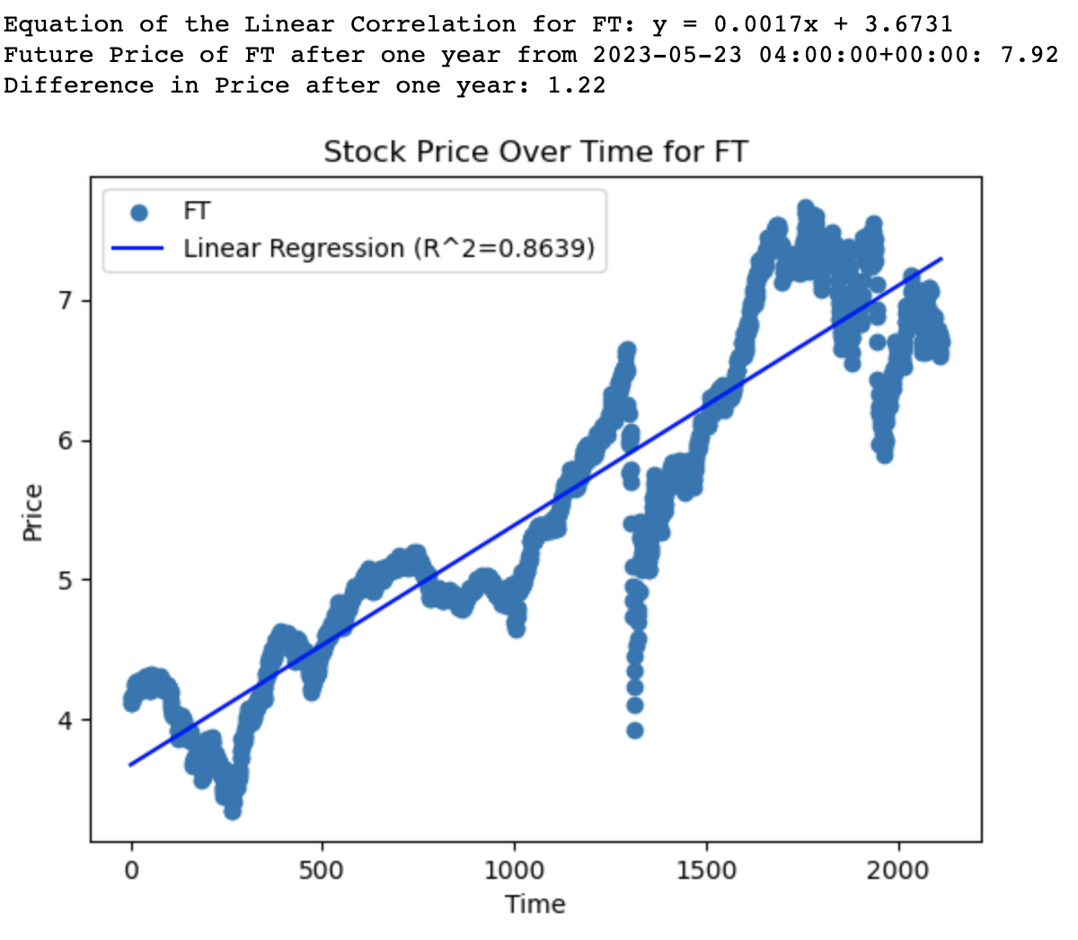
Analysis – visualizing stock price movements with scatter plots
Top stock performer in terms of lowest volatility and highest price gain
This graph indicates steady growth for FT stock, there is
certain variance, but nevertheless FT has highest gains
with lowest price variance combined. Our prediciton suggests,
Price increase of 1.22 USD.
Project/code provides such scatter plots and price differential
prediction for all the stocks that were included as top 20
stocks in terms of price gains

Slide 7
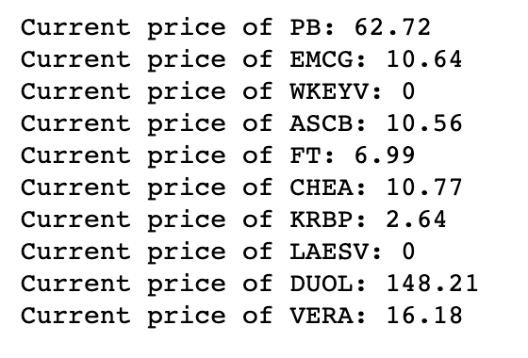
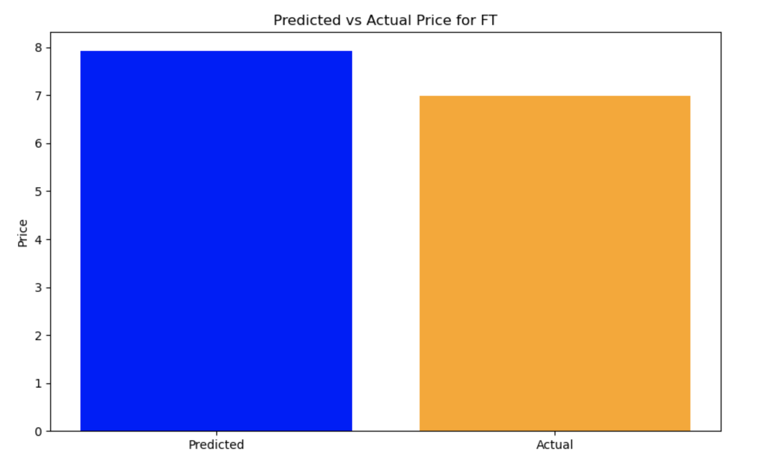
Real time comparison and future price predictions
Current price retrieval through Finnhub API
Code connects with Finnhub server and retreives current prices for the top stocks
Project/code than compares predicted price for the stocks to the actual
one and gives out a histogram visualisation of the difference

Slide 8
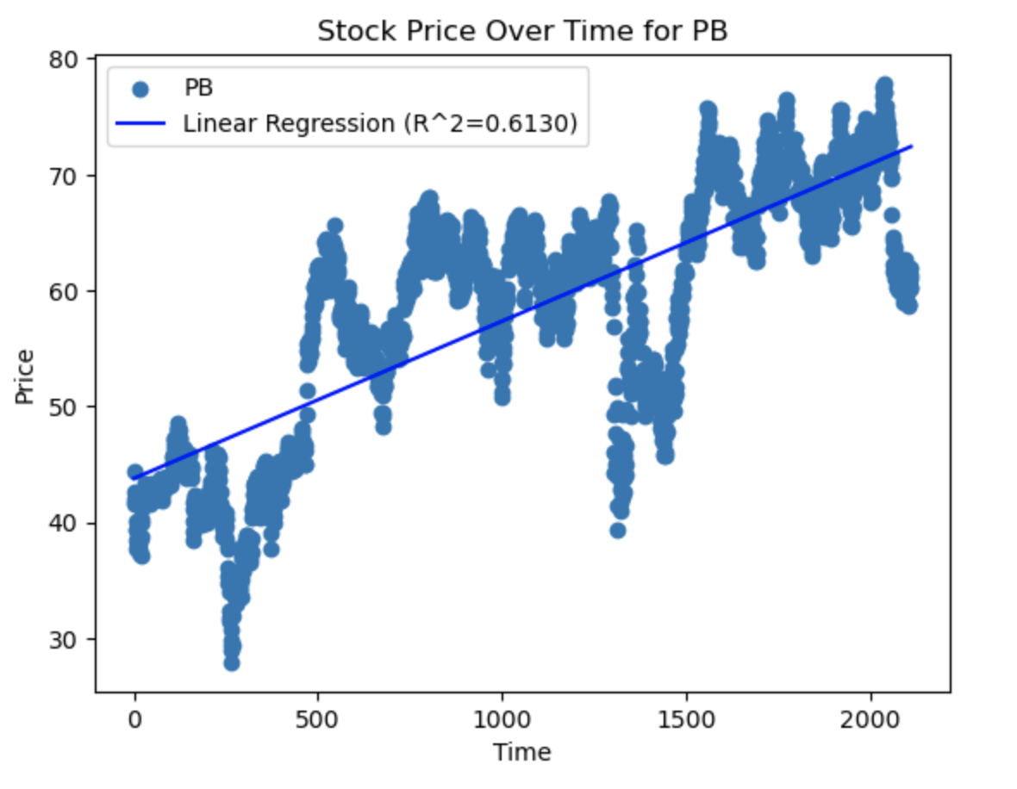
Summary of Findings
Volatility in stocks
According to our findings volatility does not necessarily determine success or failure of a stock as stock FT, was one of the
best performers, but nevertheless encountered very low volatility, whereas PB was could not perform as well, but experienced
significantly higher levels of volatility
According to analysis gathered through our project, we can say that
Volatility can be defined as risk, given the factor that prices vary
to the huge extent. However, it is not tied to performance of a stock
rather than peace of mind of an investor.
Based on this information we can suggest the top 5 stocks based
only on price:
KRBP, FT, VERA, PB, and DUOL.
the top stocks based on price stability (Standard deviation):
FT, BLNG, ERC, ELP and SAT
And the top based on price AND stability (R-squared):
FT, BLNG, SG, KRBP and TEVA

Slide 9
GitHub Repository and Readme

